Slide 1
Behavior change theory and interventions
Feb 6 2025

Slide 2
Short word or phrase from this week’s readings

Slide 3
Objective
Practice creating a “napkin pitch” for facilitating team brainstorming
Map out how theory might be applied in practice
Time needed: 55 minutes

Slide 4
Modified Napkin pitch
The idea of a “napkin pitch” is from design thinking
*(this version modified from an idea developed by Jeanne Liedtka)
We will do a version focused on interventions to motivate people to talk about climate change and heat or green spaces in their neighborhoods
Several of your reaction papers talked about efficacy and talking about climate change can be a precursor to collective action

Slide 5
Format
5 min: In pairs– choose a specific behavior
15 min: craft your napkin pitch
3+3 min: get feedback from another pair
9 min: refine your idea
10 minutes [two minutes per pair]: share out
10 minutes: debrief

Slide 6
Basic rules
Focus on at least one theory or idea from this week’s readings
Consider a specific community that you choose as your focal group
You can answer your questions with words or sketches

Slide 7
Napkin pitch basics
Need
What unmet need does this serve?
For whom?
Benefit
How will the people receiving the intervention benefit?
How will the community benefit?
Who else will benefit?
Approach
What is the theory we are working from?
Who is the intervention for?
What are the key features of the approach? What are the different ways that the intervention could meet the need?
What exists already in the community (assets, capabilities) that we can leverage in our project?
Other considerations
What else already exists that might meet this need?
What are the risks?
What other partners are necessary?
How to ensure youth leadership in brainstorming interventions, while providing necessary support?

Slide 8
Suggested considerations for team prep
Preparation 10 mins
How might this intervention build efficacy?
How can we bridge individual and collective efforts?
Alignment with theory, local/global evidence, & solutions
Implementation, capacity, sustainability, & impact
Real-world application to your context and beyond
Consider ways to integrate youth leadership and perspectives in ideation phase
Feedback for colleagues
Does the intervention capture the key variable(s) from the chosen theory?

Slide 9
Debrief
Do the theories you considered fit the task at hand (bridging individual and collective action to address climate change/ conversation)?
How would we frame the range of approaches when engaging with youth?
How do broader patterns inform local interventions & vice versa?
How would centering youth voices change the intervention approach?
What metrics would we use to evaluate the success of the interventions you chose?

Slide 10
Plus/Delta
Plus
Delta

Slide 11
Break

Slide 12
Debrief of Engagement Session (Feb 5)
Synthesis of the YPACR brainstorm activity -> What is our working definition using Sayre students’ own words?
Plus/delta of how the session went with each small group
Others?

Slide 13
YPARC
a research approach where adults support youth to use their knowledge and strengths to study issues that influence them and ultimately make a change
Youth: growing, learning ; Participatory: balancing engagement from folks who have different experiences and expertise (and power) ; Action: achieving change ; Research: finding new information ; Communication: conversations, sharing ideas
gathering and sharing information to achieve change while we learn and grow together, where youth are both enacting AND making decisions
to empower youth to gather information and learn more about what they find meaningful/important and use this research to enact change (through comm :))
youth and researchers work together to gather information and share ideas to create change in their communities
an approach to research that empowers youth to participate in research that directly affects them while allowing them to communicate important details regarding the topic.
a method of investigating a problem and implementing a solution that involves the knowledge and leadership of adolescents in a participatory process, with attention to theories involved in communication studies
Notes:
a method of investigating a problem and implementing a solution that involves the knowledge and leadership of adolescents in a process of sharing ideas and information, learning, and growth--with attention to theories involved in communication studies

Slide 14
Youth, Participatory, Action, Research in Communication
Y: Young people in a stage in life where they are developing their sense of self
P: Coming together to share ideas and make decisions through collaborative activities
A: Making change happen, based on what we know and learn
R: Investigation into a question or problem that involves gathering information, making meaning, and sharing findings
C: Sharing information and cooperating to reach understanding

Slide 15
Synthesized definition
A method of investigating a problem, gathering information, and implementing a solution that involves the knowledge of young leaders in a process of sharing ideas and information, learning, and growth—in collaboration with researchers and community members—with attention to sharing knowledge/information and reach community understanding.
Notes:
Notes
growing and learning together
emphasize that the goal is to empower in response to the negative responses about youth in the activity
most potential misalignment around “participatory”; distinction between who makes decisions and who participates
highlight empowerment that they’re making decisions as part of the participatory process
communication: what role does this play? → use broad definition, name the idea that we can systematically study communication / how information flows
define communication and research instead of using them
reword to remove jargon/make language accessible
proposal: include 2 slides—one summarizing each word, one joining them into a collective definition
a method of investigating a problem and implementing a solution that involves the knowledge and leadership of adolescents in a process of sharing ideas and information, learning, and growth--in collaboration with researchers and community members-- with attention to theories involved in communication studies

Slide 16
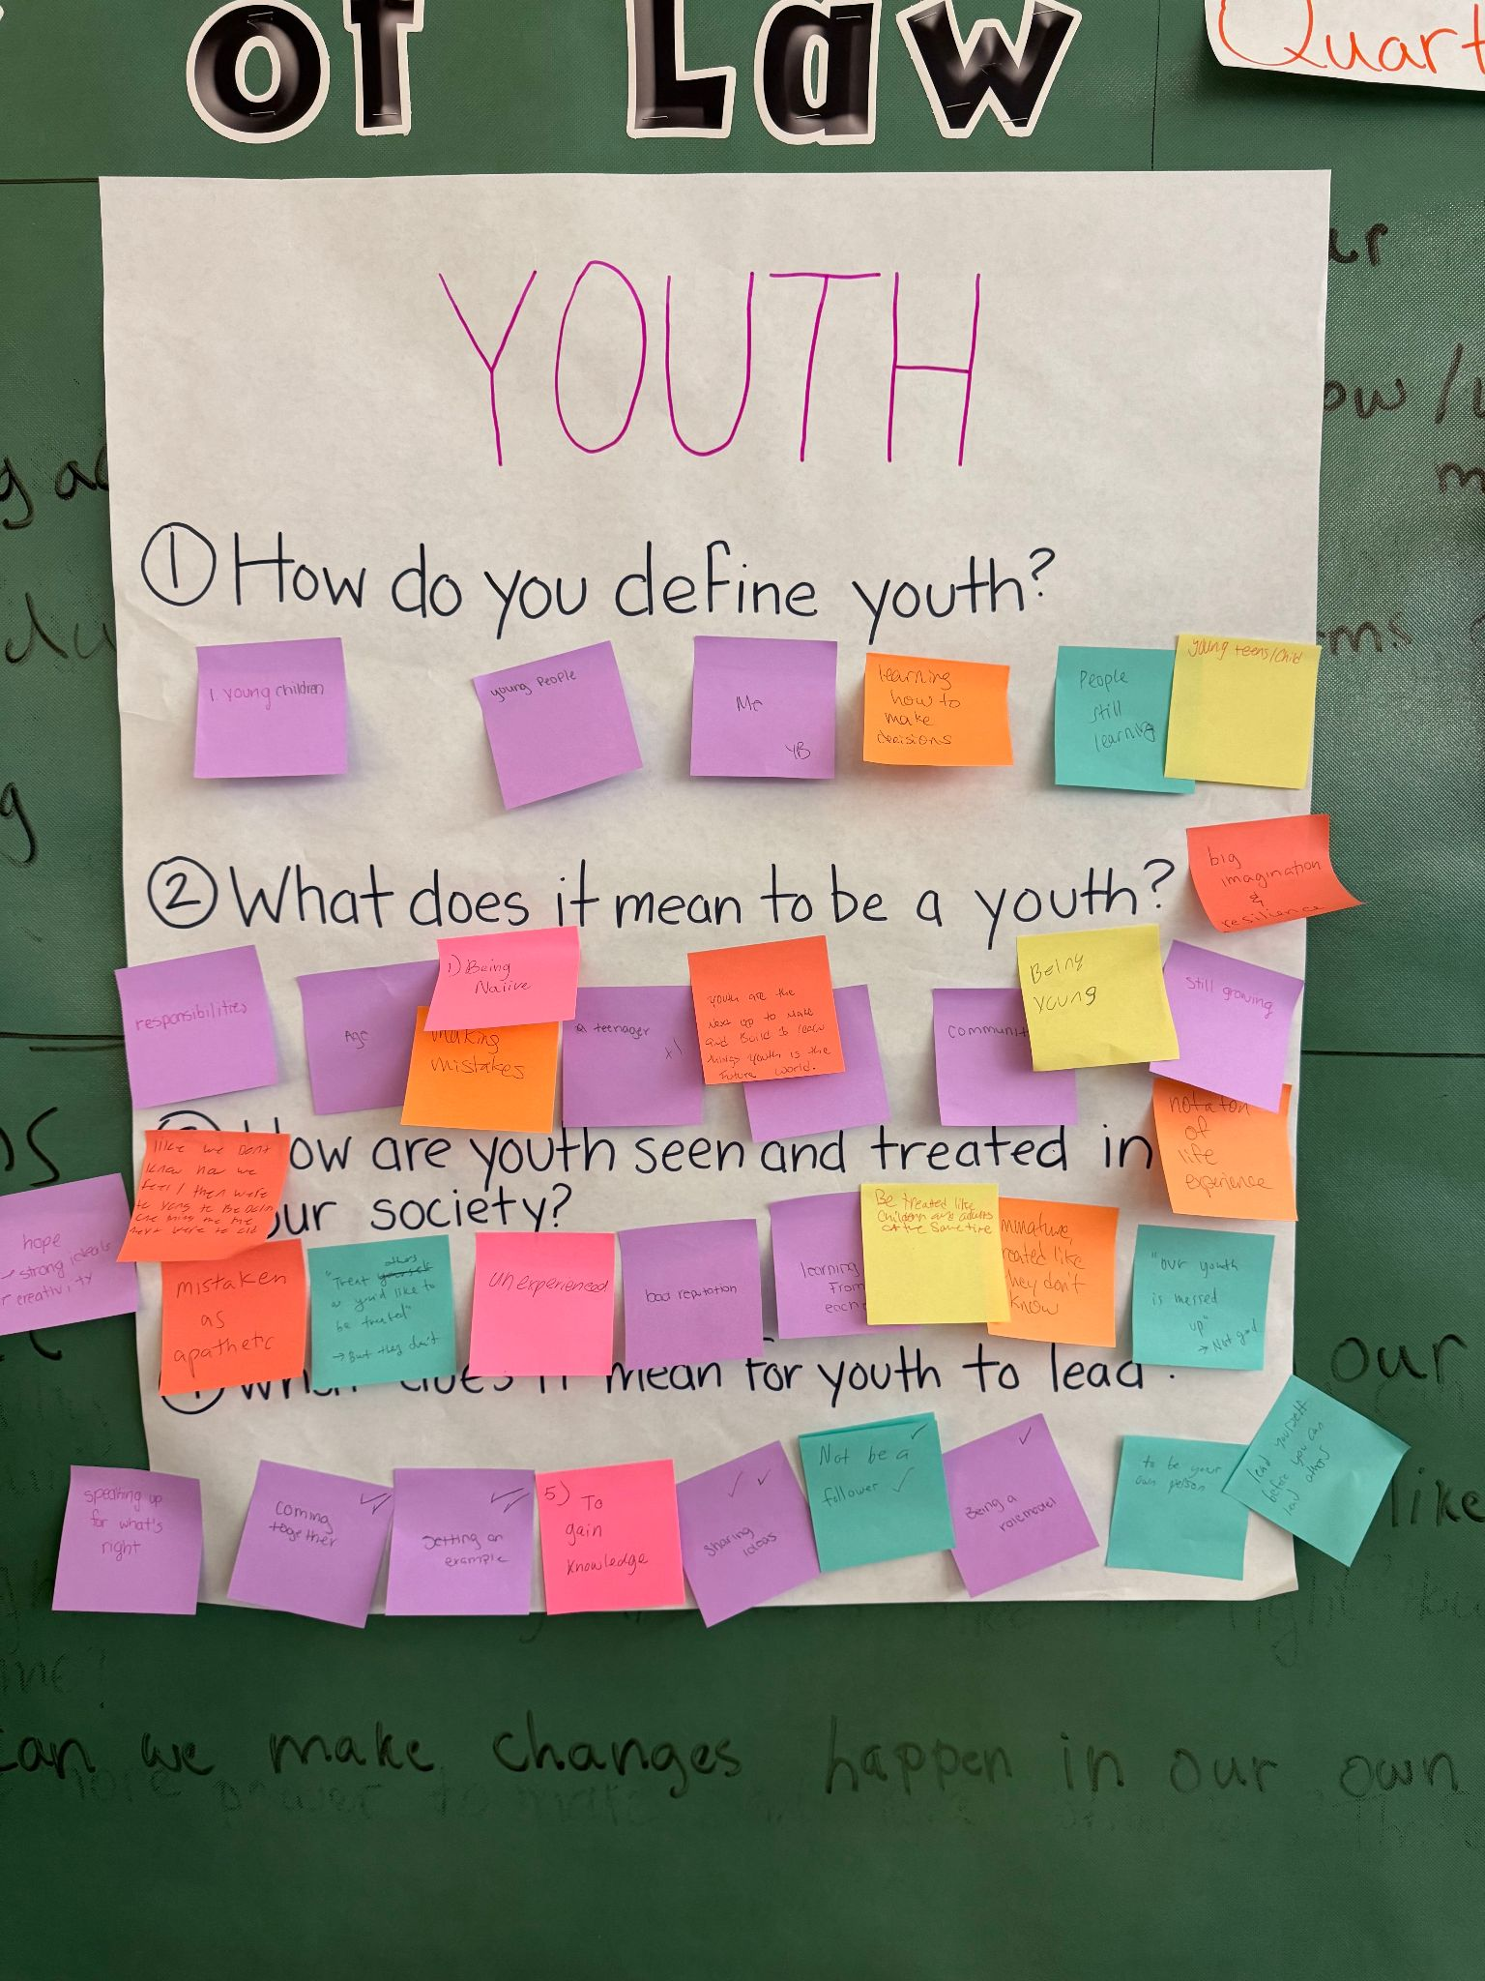
Q1. How do you define youth?
Young children
Young people
Me
Learning how to make decisions
People who are still learning
Young teens/child
Q3. How are youth seen and treated in our society?
Like we don’t know how we feel/
Mistaken as apathetic
Hope and strong ideals, and creativity
“Treat others as you’ll like to be treated” but they don’t
Unexperienced
Bad reputation
Learning from each other
Be treated like children and adults at the same time
Immature, treated like they don’t know
“Our youth is messed up” not good
Q2. What does it mean to be a youth?
Responsibilities
Age
Being naive
Making mistakes
Teenager (+)
Youth are the next up to make and build and learn things
Youth is the future of the world
Community
Being young
Still young
Still growing
Not a ton of life experience
Big imagination & resilience
Q4. What does it mean for youth to lead?
Speaking up for what’s right (++)
Coming together
Setting an example (++)
To gain knowledge
Sharing ideas (++)
Not be a follower (++)
Being a role model (+)
To be your own person
Lead yourself before you can lead others

Slide 17
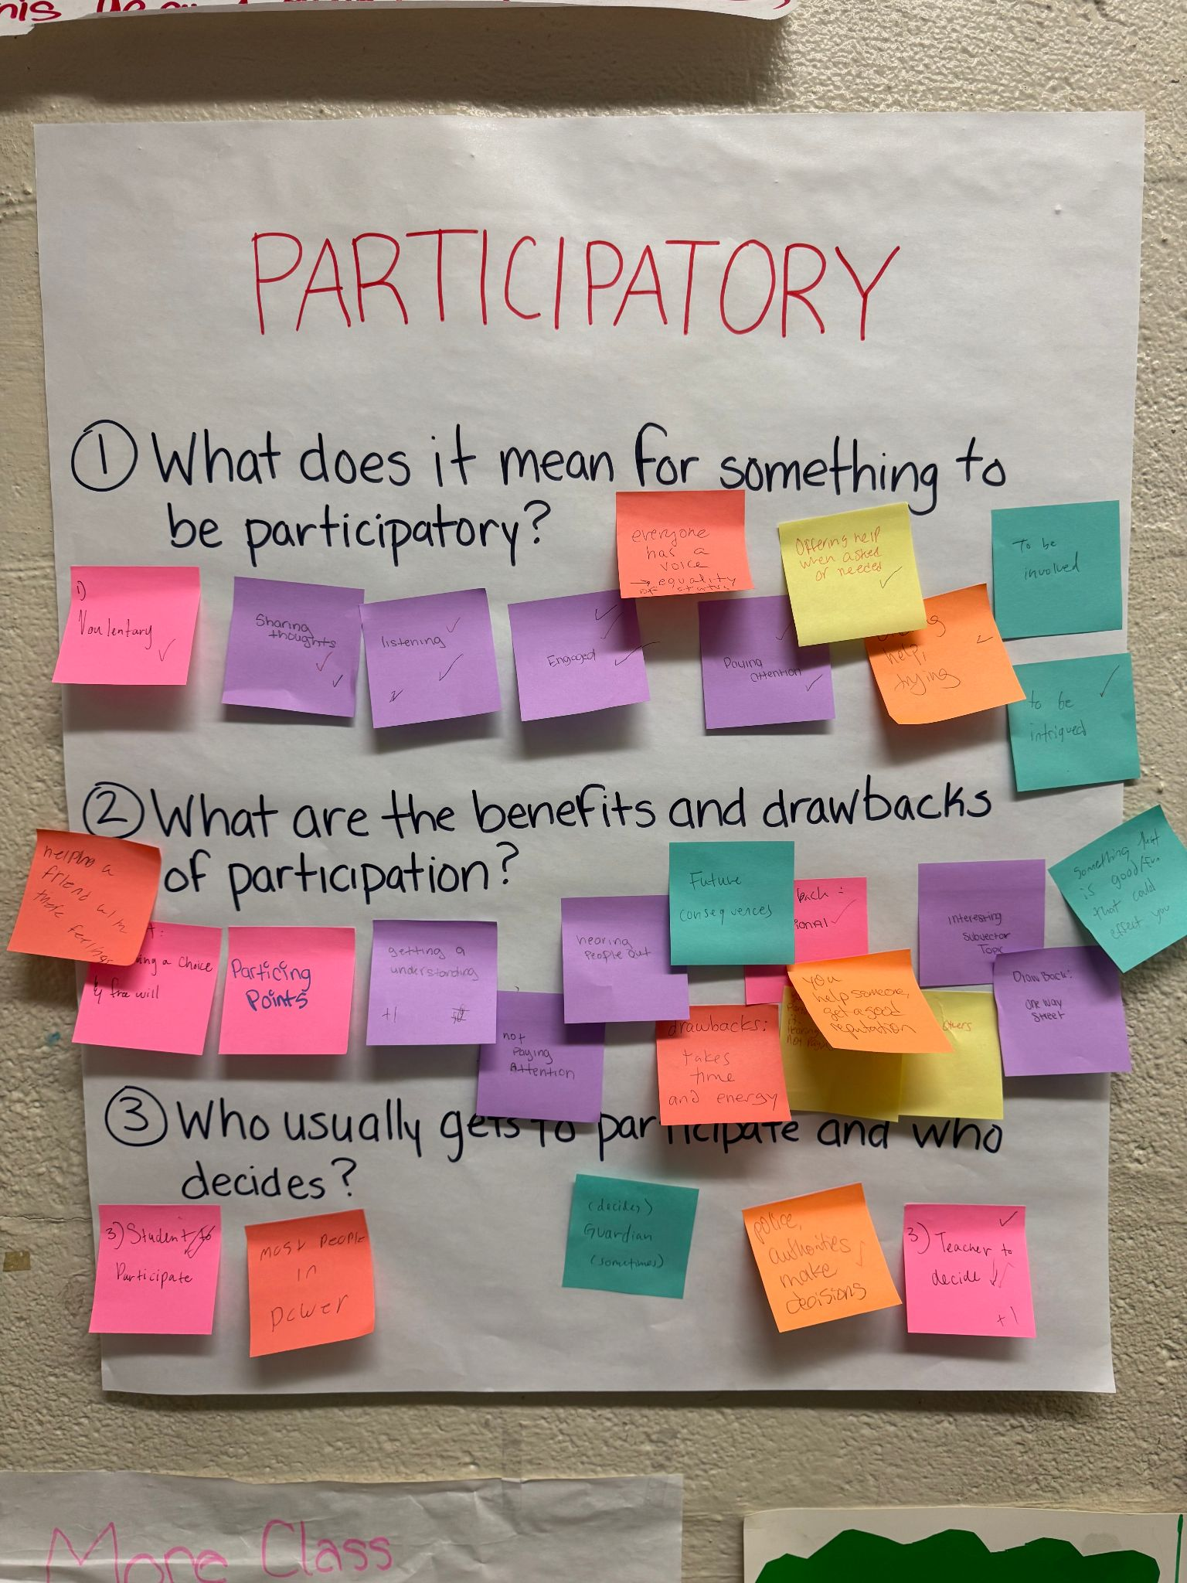
Q1. What does it mean to be participatory?
Voluntary (+)
Sharing thoughts (++)
Listening (+++)
Engaged (+++)
Everyone has a voice, equality of status
Paying attention (++)
Offering help when asked or needed (+)
Offering help or trying (+)
To be involved
To be intrigued (+)
Q2. What are benefits and drawbacks of participation?
Benefits:
Helping a friend with their feelings
Having a choice, free will
Practicing points
Getting an understanding (+)
You help someone and get a good reputation
Hearing people out (+)
Interesting subject or topic
Something that is good or fun that will affect you
Drawbacks:
Not paying attention (+)
Future consequences
Takes time and energy
Emotional (+)
Not giving others a chance to participate and overdoing it
One way street
Q3. Who usually gets to participate and decide?
Student to participate (++)
Most people in power
Decide - Guardian (sometimes)
Police, authorities make decisions (+)
Teacher to decide (++++)

Slide 18
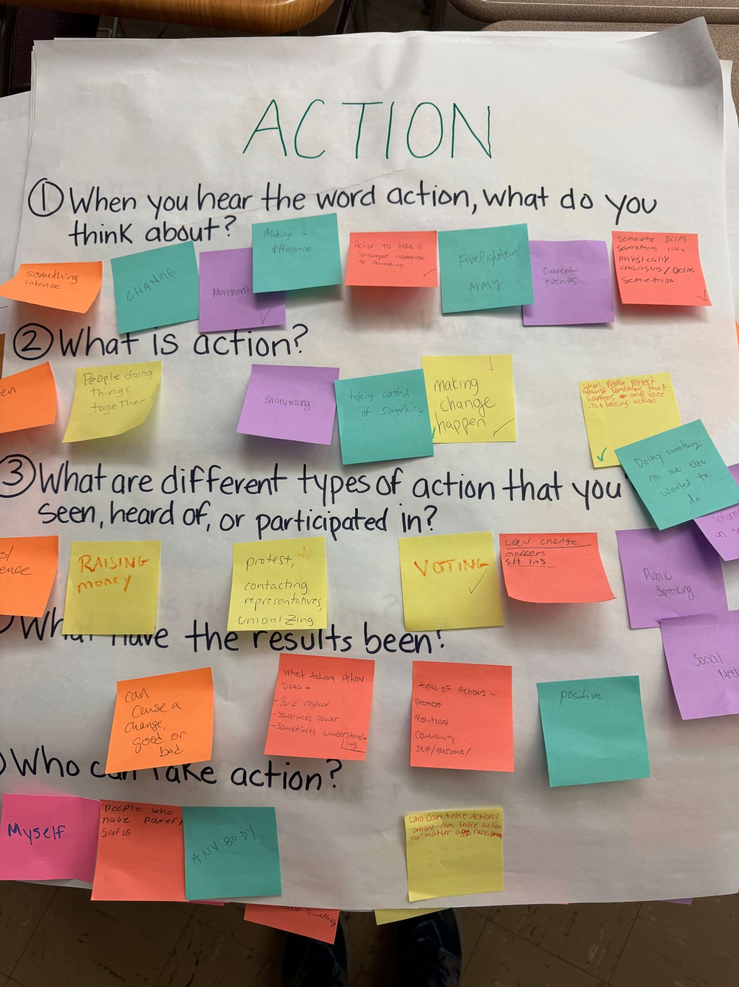
Q1. When you hear the word action what do you think about?
Something intense
Change
Movement (+)
Making a difference
Action - to take a stronger response to something (+)
Firefighter and army
Current events
Someone being something like physically changing/ doing something
Q3. What are different types of action you seen, heard, or participated in?
Riots/ violence
Raising money
Protest (+)
Political
Community
Self/personal
Contacting representatives
Unionizing
Voting (+)
Law change
Marches
Sit ins
Public speaking
Social media
Sharing information in social media
Q2. What is action?
Sudden act
People doing things together
Storytelling
Taking control of something
Making change happen (+++)
When people protest against something that happens and voice it’s taking action
Doing something no one else wanted to do
Q4. What were the results?
Can cause a change, good or bad
What taking action does - build respect, sometimes power, sometimes understanding
Positive
Q5. Who can take action?
Myself
People who have power/ SCOTUS
Anybody
Anyone who can take action, no matter age, race, gender
Notes:
Using what we find out in our research to make change happen.

Slide 19
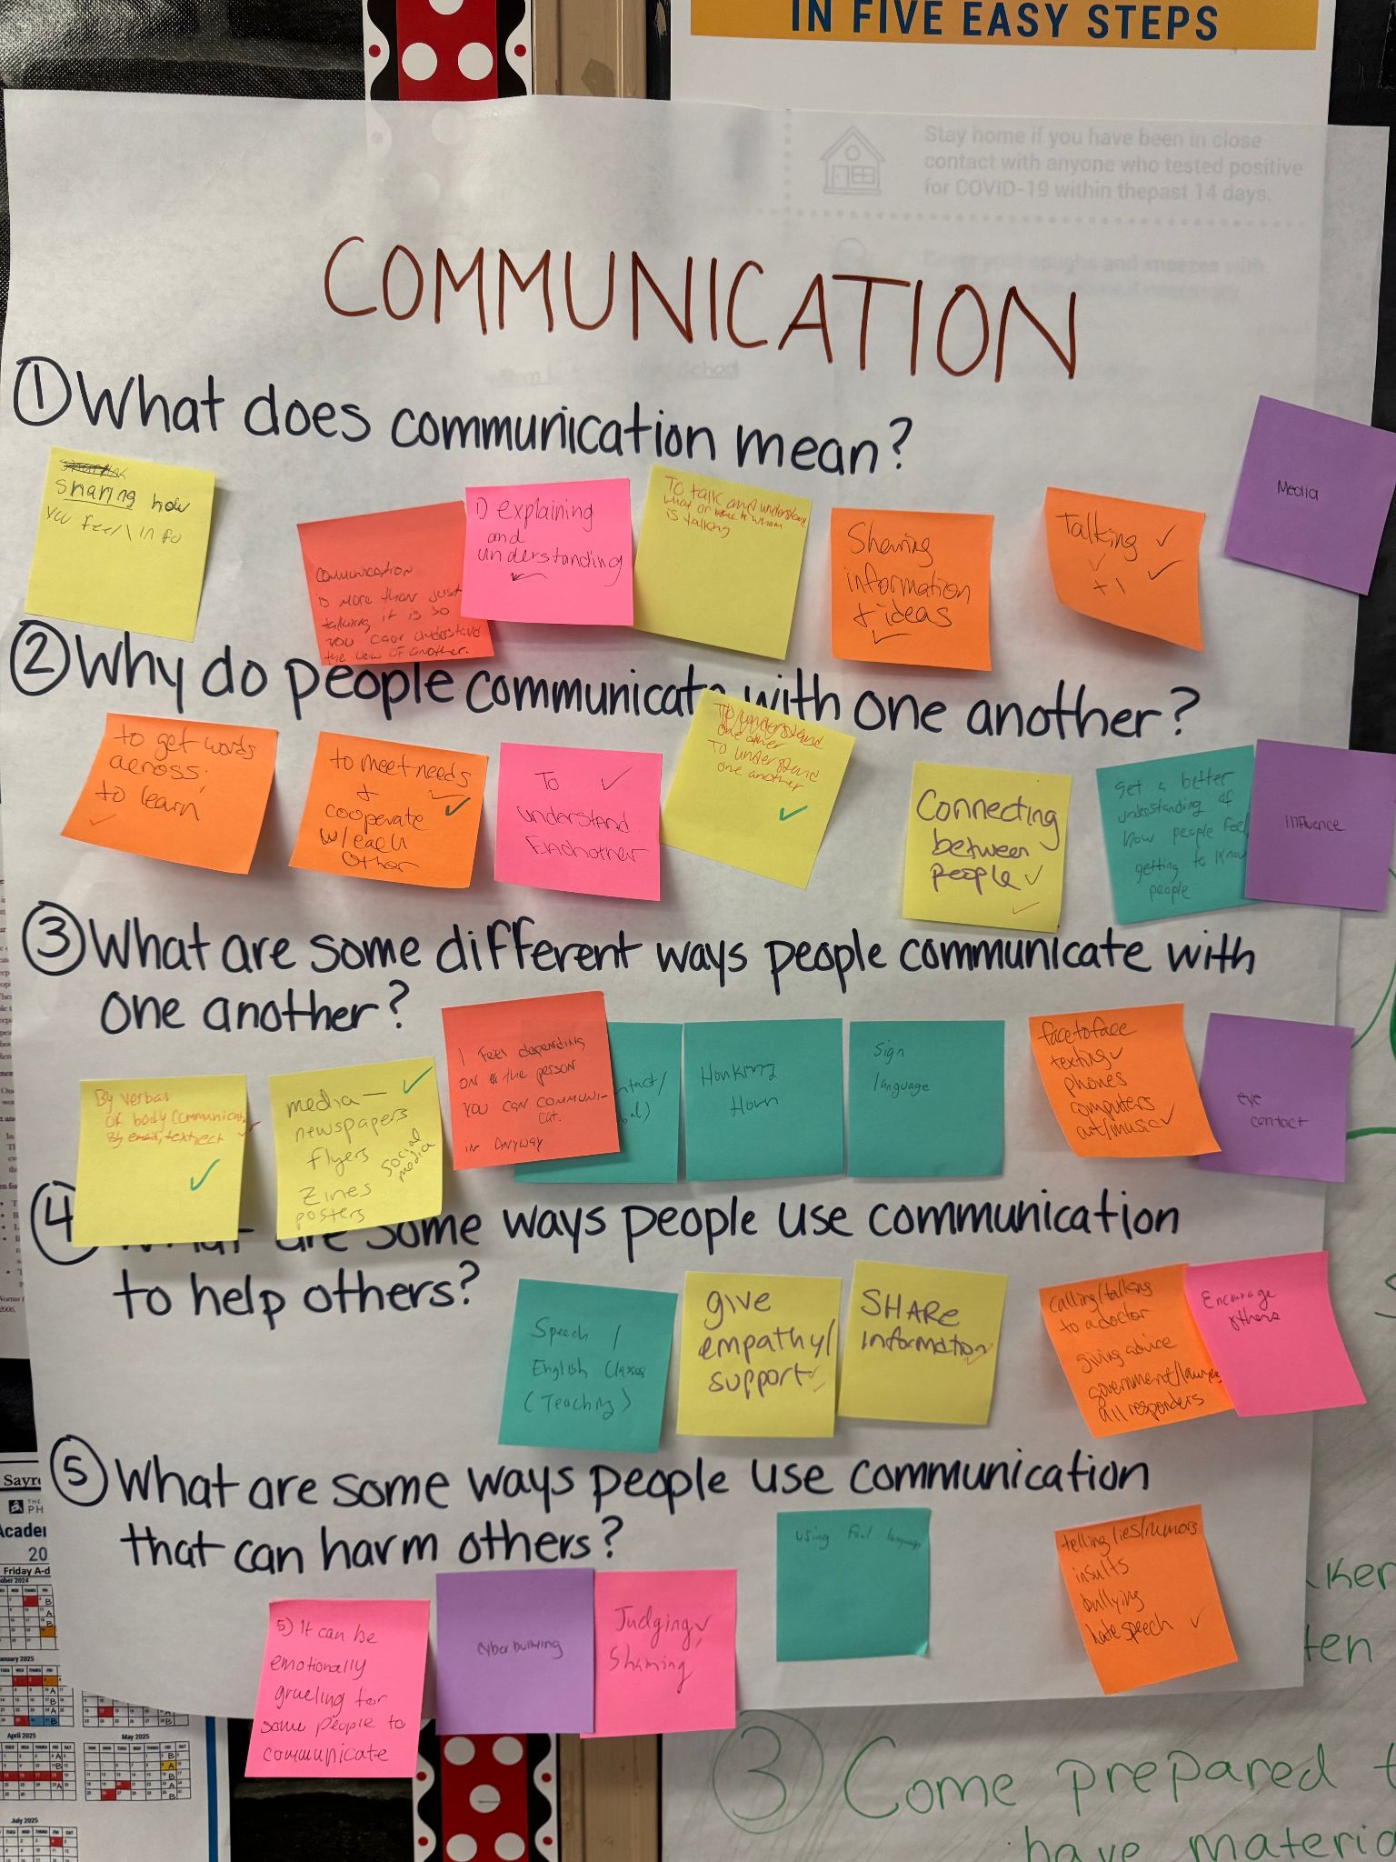
Q1. What does communication mean?
Sharing how you feel/ information
Comunication is more than just talking it is so you can understand the view of another
Explaining and understanding (+)
To talk and understand what or whom is talking
Sharing information of ideas (+)
Talking (++++)
Media
Q3. What are different ways people communicate?
By verbal or body communication, by email, text, etc. (++)
Media, newspapers, flyers, Zines, posters, Social media (+)
I feel depending on the person you can communicate in any way
Eyes, eye contact/nonverbal (+)
Honking horn
Sign language
Face to face, texting, phones, computers, art, music (++)
Q2. Why do people communicate?
To get words across, to learn (+)
To meet needs and cooperate with each other (+)
To understand each other/one another (+++)
Connecting between people (+)
Get a better understanding of how people feel/ getting to know people
Influence
Q4. What are some ways people use communication to help others?
Speech/ English classes (teaching)
Give empathy/support (++)
Share information (+)
Calling/talking to a doctor
Giving advice
Government/lawyers
All responders
Encourage others
Q5. What are some ways people use communication to harm others?
It can be emotionally gruelling for some people to communicate
Cyber bullying
Judging, shaming (+)
Using foul language
Telling lies, rumors, insults, bullying, hate speech (+)

Slide 20
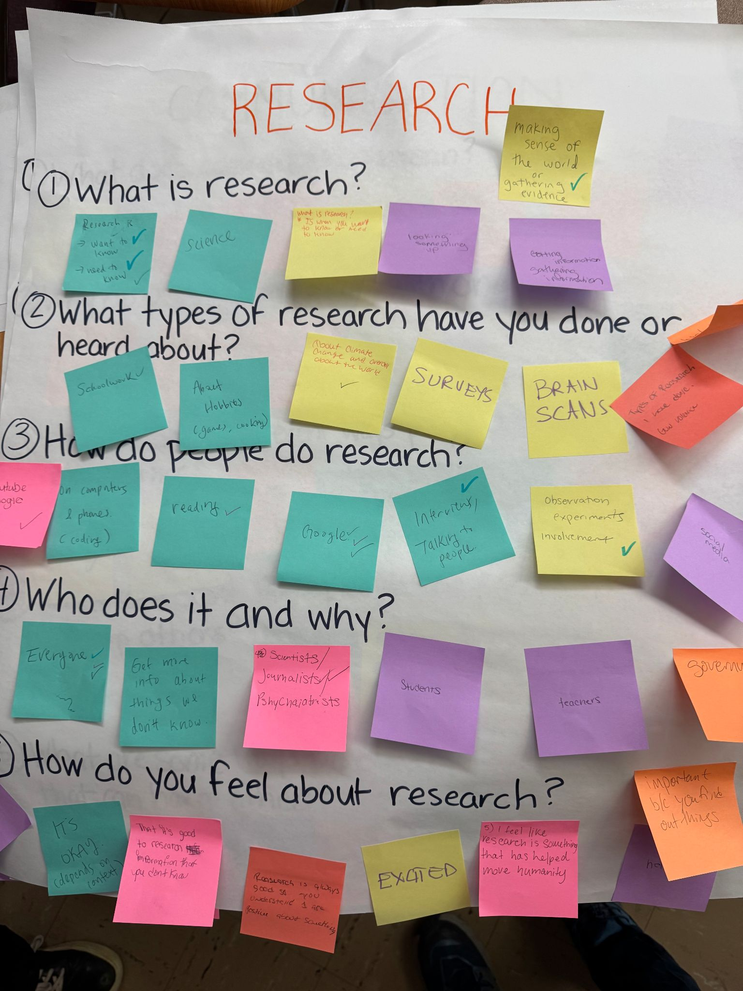
Q1. What is research?
Research is Want to know and Need to know (++++)
Science
Looking something up
Making sense of the world or gathering evidence (+)
Getting information, gathering information
Q4. Who does research and why?
Everyone (+++)
Get more info about things we don’t know
Scientists, journalists (++), psychiatrists
Students’
Teachers
Government
Q2. What types of research have you done or heard about?
Schoolwork (+)
About hobbies (games, cooking)
About climate change and overall about the world (+)
Surveys
Brain scans
Gun violence
Historical research using the internet
Q5. How do you feel about research?
Interested
It’s okay, depends on the context
That it’s good to research information that you don’t know
Research is always good so you understand and are positive about something
Excited
I feel like research is something that has helped move humanity
Important because you find out things
Helpful (+)
Q3. How do people do research?
YouTube, Google (+)
On computers and phones (coding)
Reading (+)
Google (+++)
Interviews/talking to people (+)
Observation, experiments, involvement (+)
Social media

Slide 21
Planning Next Engagement Session (Feb 12)
Outline of planned engagement session #2
What materials do we have to prepare?

